Slide 1

Data Structures Binary Search Trees II
Dr. Wedad Hussein
Information Systems Department
wedad.hussein@cis.asu.edu.eg
Dr. Hanan Hindy
Computer Science Department
hanan.hindy@cis.asu.edu.eg

Slide 2
Course Contents
Pointers & Classes.
Stacks
Queues
Array Lists
Linked Lists
Binary Search Trees I
Binary Search Trees II + STL
Hash Tables
Graphs

Slide 3
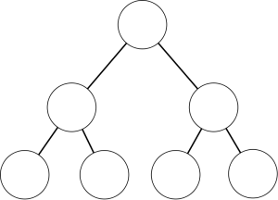
Binary Search Trees

Slide 4
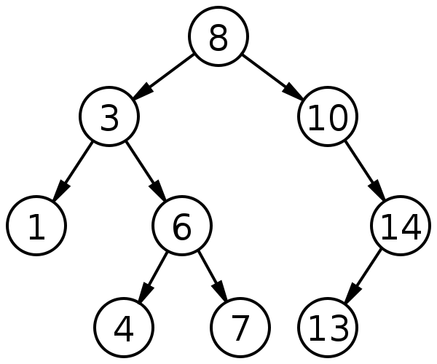
Binary Search Tree Recap

Slide 5
BST Operations
Contains(value): returns true if “value” exists in the tree.
Insert(value): adds a value to the tree.
Traverse: (display) displays all nodes in the tree.
Remove(value): deletes a node from the tree.

Slide 6
BST Operations
Contains(value): returns true if “value” exists in the tree.
Insert(value): adds a value to the tree.
Traverse: (display) displays all nodes in the tree.
Remove(value): deletes a node from the tree.
Helper Function:
Find Parent: Returns the parent of the given value.

Slide 7
Find Parent Example
NULL
b
60
a
>46
FindParent(46)
41
74
16
53
65
25
46
55
63
70
64

Slide 8
Find Parent Example
>46
60
b
FindParent(46)
41
a
74
16
53
65
25
46
55
63
70
64

Slide 9
Find Parent Example
60
b
FindParent(46)
41
a
74
<46
16
53
65
25
46
55
63
70
64

Slide 10
Find Parent Example
60
FindParent(46)
41
b
74
<46
16
53
a
65
25
46
55
63
70
64

Slide 11
Find Parent Example
60
FindParent(46)
41
b
74
16
53
a
65
>46
25
46
55
63
70
64

Slide 12
Find Parent Example
60
FindParent(46)
41
74
16
53
b
65
>46
25
46
55
63
70
a
64

Slide 13

Remove

Slide 14

Remove
You are faced with three different cases:
Remove a leaf node.
Remove a node with one child.
Remove a node with two children.

Slide 15
Remove a leaf node.
60
Remove(42)
41
74
16
53
65
25
46
55
63
70
42
64

Slide 16
Remove a leaf node.
60
Remove(42)
Locate parent node and set pointer to NULL
41
74
16
53
65
25
46
55
63
70
42
64

Slide 17
Remove a node with one child.
60
Remove(16)
41
74
16
53
65
25
46
55
63
70
42
64

Slide 18
Remove a node with one child.
60
Remove(16)
Replace the node with its child
41
74
16
53
65
25
46
55
63
70
42
64

Slide 19
Remove a node with one child.
60
Remove(16)
41
74
25
53
65
46
55
63
70
42
64

Slide 20
Remove a node with one child.
60
Remove(74)
41
74
16
53
65
25
46
55
63
70
42
64

Slide 21
Remove a node with one child.
60
Remove(74)
Replace the node with its child
41
74
16
53
65
25
46
55
63
70
42
64

Slide 22
Remove a node with one child.
60
Remove(74)
41
65
25
53
63
70
46
55
64
42

Slide 23
Remove a node with two children.
60
Remove(41)
41
74
16
53
65
25
46
55
63
70
42
64

Slide 24
Remove a node with two children.
60
Remove(41)
Find the smallest value in the right subtree
41
74
16
53
65
25
46
55
63
70
42
64
Notes:
Or the largest value in the left subtree

Slide 25
Remove a node with two children.
60
Remove(41)
Find the smallest value in the right subtree
41
74
16
53
65
25
46
55
63
70
42
64

Slide 26
Remove a node with two children.
60
Remove(41)
Replace the value of the deleted node
42
74
16
53
65
25
46
55
63
70
42
64

Slide 27
Remove a node with two children.
60
Remove(41)
Remove the smallest node
42
74
16
53
65
25
46
55
63
70
64

Slide 28
Remove a node with two children.
60
Remove(60)
41
74
16
53
65
25
46
55
63
70
42
64

Slide 29
Remove a node with two children.
60
Remove(60)
Find the smallest value in the right subtree
41
74
16
53
65
25
46
55
63
70
42
64

Slide 30
Remove a node with two children.
60
Remove(60)
Find the smallest value in the right subtree
41
74
16
53
65
25
46
55
63
70
42
64

Slide 31
Remove a node with two children.
63
Remove(60)
Replace the value of the deleted node
42
74
16
53
65
25
46
55
63
70
42
64

Slide 32
Remove a node with two children.
63
Remove(60)
Remove the smallest node
42
74
16
53
65
25
46
55
64
70
42

Slide 33
Binary Search Trees Variations

Slide 34
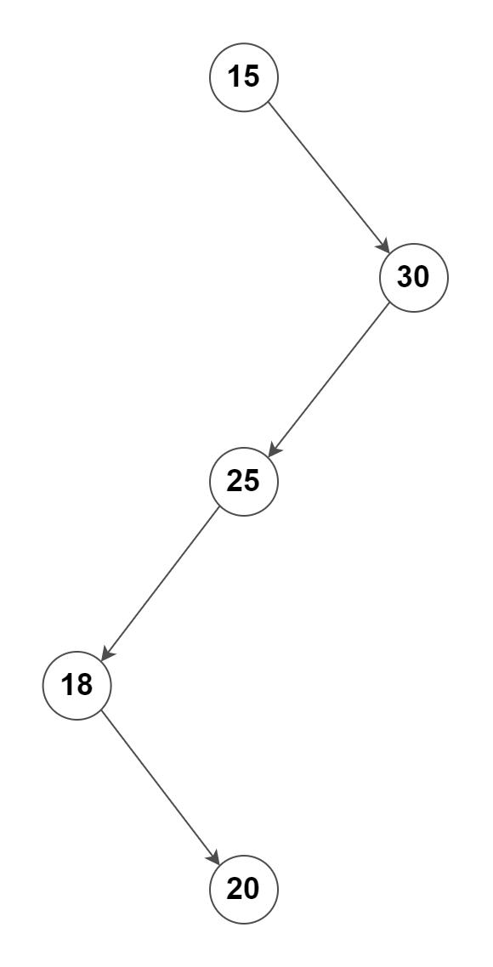
What is the Complexity of the following BSTs?
30
20
22
25
O(n)
25
22
30
20

Slide 35
Solution?
Balanced Binary Search Trees.
Guaranteed a height of log(n) for n items.

Slide 36
1- Red-Black Trees
Red-Black Tree is a self-balancing Binary Search Tree (BST) where every node follows the following rules:
Every node has a color either red or black.
Root of tree is always black.
There are no two adjacent red nodes (A red node cannot have a red parent or red child).
Every path from root to a leaf node has same number of black nodes.

Slide 37
1- Red-Black Trees
19
5
50
2
15
33
55
4
18
26
42
45

Slide 38
2- AVL Trees
AVL (Adelson-Velsky and Landis) tree is a self-balancing Binary Search Tree (BST) where the difference between heights of left and right subtrees cannot be more than one for all nodes.
The balance condition ensures that the depth of the tree is O(logN).
Condition: for every node in the tree, the height of the left and right subtrees can differ by at most 1.

Slide 39
2- AVL Trees
(1)
(2)
7
5
2
8
2
8
1
4
1
4
7
3
5
3

Slide 40


Slide 41
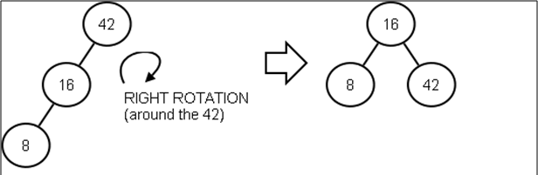
2- AVL Trees - Rotation

Slide 42
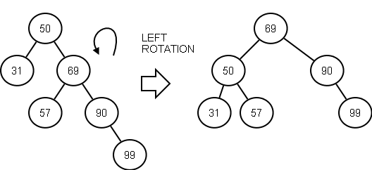
2- AVL Trees - Rotation

Slide 43
Binary Search Trees in STL

Slide 44
1- sets
Sets are containers that store unique elements following a specific order.
Declaration:
Adding values:
Note: if the value already exists, it will not be added.
set<int> s;
s.insert(100);

Slide 45
Iterators with sets
You can use an iterator to access values.
Works the same way as in-order traversal.
set<int>::iterator it;
for(it=s.begin();it!=s.end();it++)
cout<<*it<<endl;

Slide 46
2- maps

Slide 47
Before maps, Pairs
This class couples together a pair of values.
They can be of different types.
Examples:
pair<type1, type2> p;
pair<string, string> p;
pair<int, string> p;

Slide 48
Pairs
The individual values can be accessed through its public members first and second.
p.first= “Ahmed";
p.second=“Engineer";
cout<<p.first<<" "<<p.second<<endl;

Slide 49
make_pair
Constructs a pair object with its first element set to x and its second element set to y.
pair<T1,T2> make_pair (T1 x, T2 y);
pair <string,string> p;
p=make_pair(“Ahmed",“Engineer");

Slide 50
Using pairs with other Data Structures
vector<pair<string,string>> v;
v.push_back(make_pair("Salma","Doctor"));
v.push_back(make_pair("Ahmed","Engineer"));
v.push_back(make_pair("Mohamed","Teacher"));
for(int i=0;i<v.size();i++)
cout<<v[i].first<<" "<<v[i].second<<endl;

Slide 51
2- maps
Declared as:
You can use the ([]) operator to access, add, or edit elements:
map<key type, value type>
map<string,string> jobs;
jobs["Salma"] = "Doctor";
jobs["Ahmed"] = "Engineer";
jobs["Mohamed"] = "Teacher";
cout<< jobs["Ahmed"]<<endl;

Slide 52
Iterators with maps
You can use an iterator to access values.
Works the same way as in-order traversal.
map<string,string>::iterator it;
for(it=jobs.begin();it!=jobs.end();it++)
cout<<it->first<<" "<<it->second<<endl;

Slide 53
map functions
at(k): returns the value associated with key k (works the same way as [] operator).
begin(): returns an iterator pointing at the start of the table.
end(): Returns an iterator pointing to the past-the-end element.
empty(): Returns a bool value indicating whether the container is empty.
find(k): Searches the container for an element with k as key and returns an iterator to it if found, otherwise it returns the same iterator as the function end()

Slide 54
map functions
insert(pair): inserts the key-value pair given as a parameter into the map.
erase(k): removes the element with key k.
jobs.insert(make_pair("Mona", "SWE"));
jobs.erase("Ahmed");

Slide 55
Lecture Resources
Lecture Notes.
Lecture Code.
Textbook:
Chapter 4: 4.3, 4.8

Slide 56


